Slide 1

US Immigration Statistics (1980-2021)
This presentation is done from a dataset that describes annual statistics regarding US immigration between the 1980-2021 fiscal years.

Slide 2

Team Members and their Roles
1. Sai Teja Rayabarapu: Team Lead
2. VARSHA TELUGU: Responsible for managing the GCP Console environment
3. Manaswini Kodela: Designing of overall data architecture on GCP
4. Cierra Tolbert-Hoosier: Responsible on securing sensitive data and compliance with data privacy regulations
5. Murali Madhyahnapu: Finding and Exploring the data set.
6. Sai Deekshitha Makineni: Responsible on data cleaning

Slide 3
Problem Statement
This project aims to analyze immigration and noncitizen data in the United States, focusing on key metrics such as "Year," "Immigrants Achieving Lawful Permanent Resident Status," "Refugee Arrivals," "Noncitizen Apprehensions," "Noncitizen Removals," and "Noncitizen Returns." The objective is to identify trends, patterns, and relationships within these data points to inform policymakers, immigration authorities, and researchers about evolving immigration trends, aiding in informed decision-making.

Slide 4
Who is asking for the data and Why?
USCIS (U.S. Citizenship and Immigration Services) utilizes our data to inform the development of immigration policies and resource allocation for improved immigration procedures.
The data aids in identifying fraud, assessing performance, and enhancing national security initiatives to ensure the integrity of the U.S. immigration system.
USCIS relies on this data analysis to anticipate resource requirements and efficiently administer immigration services.
By studying the results, USCIS strives to uphold the ideals of the U.S. immigration system and enhance customer service for those navigating the immigration process.

Slide 5
What do USCIS want to find out from the data?
Policy Formulation: USCIS aims to use the data to make informed decisions about immigration policies. They can assess trends in "Immigrants Obtaining Lawful Permanent Resident Status" and "Refugee Arrivals" to determine the effectiveness of existing policies and potentially develop new ones.
National Security Enhancement: USCIS is interested in "Noncitizen Apprehensions" and "Noncitizen Removals" to strengthen national security. Analyzing these variables helps identify potential security threats and assess the effectiveness of measures in place to apprehend and remove noncitizens who pose risks.
Resource Allocation: USCIS seeks to allocate resources wisely by analyzing these data points. Understanding fluctuations in "Refugee Arrivals," "Noncitizen Apprehensions," and "Noncitizen Removals" over the years can inform resource planning and distribution to address changing demands.
Process Improvement: USCIS is likely interested in optimizing its procedures related to immigration services and national security. By studying data on "Noncitizen Returns" and "Immigrants Obtaining Lawful Permanent Resident Status," they can identify areas where processes can be improved to enhance customer service and streamline operations.

Slide 6

Finding and Collecting the Data
The data is retrieved from the Department of Homeland Security between the years 1980-2021 which has the following categories:
Year
Immigrants Obtaining Lawful Permanent Resident Status
Refugee Arrivals
Noncitizen Apprehensions
Noncitizen Removals
Noncitizen Returns

Slide 7
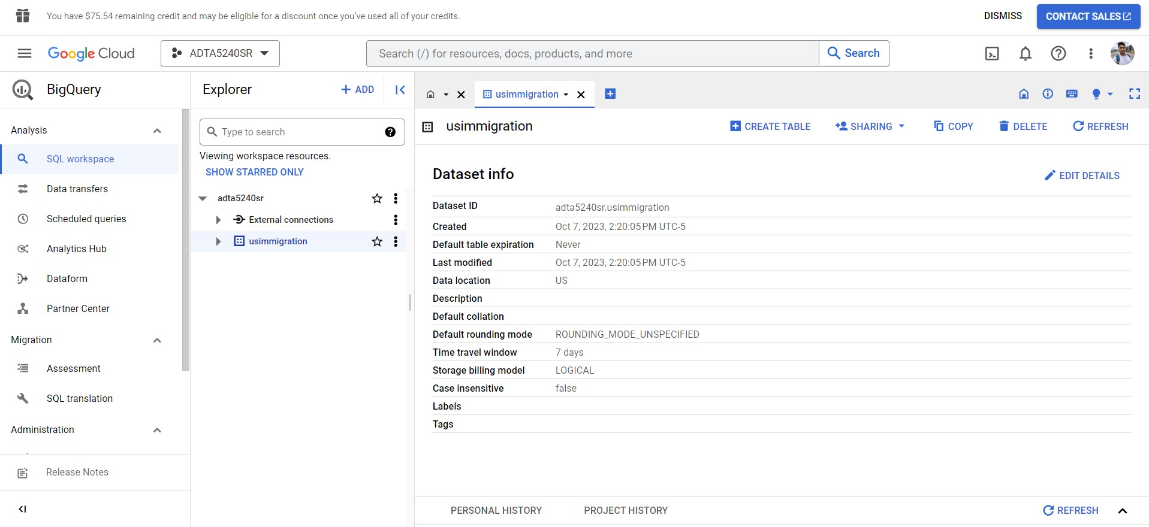
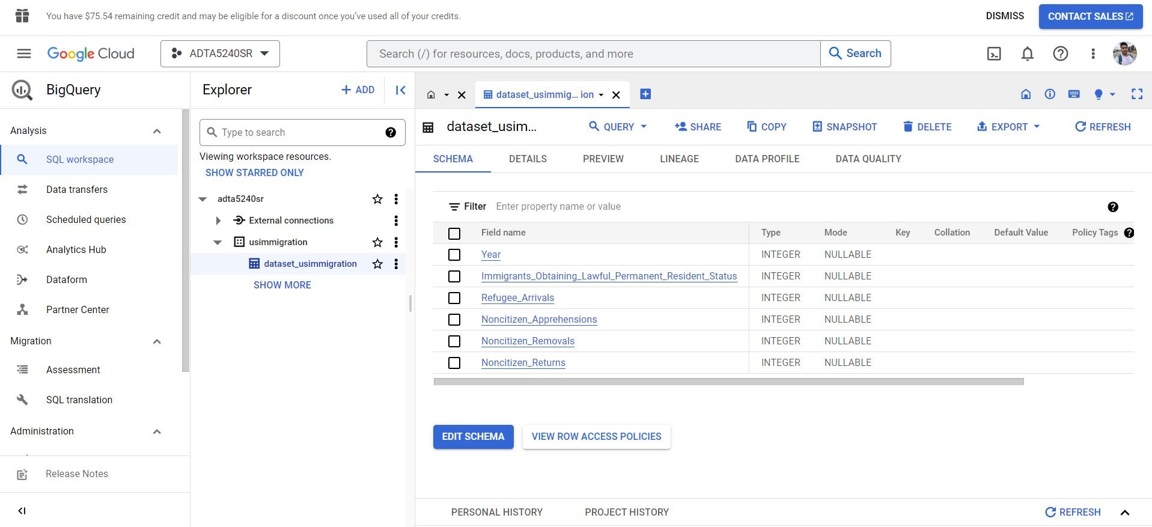
From Data to Data Analysis
Created and Uploaded the Data Set

Slide 8
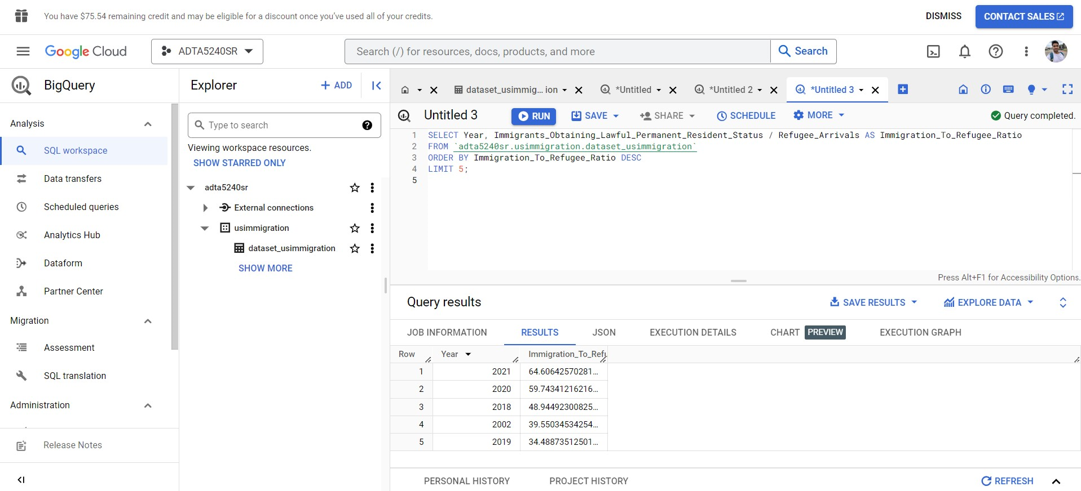
Executing Queries in Big Query
Top 5 Years with Highest Immigration-to-Refugee Ratio

Slide 9
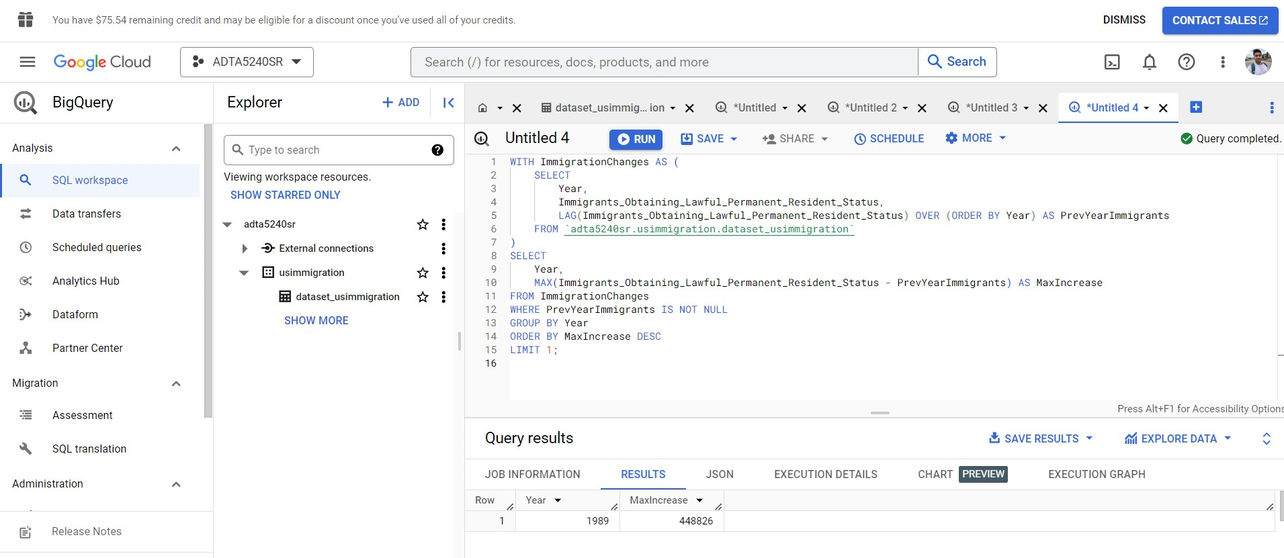
Finding the Year with the Highest Increase in Immigration Over the Previous Year

Slide 10
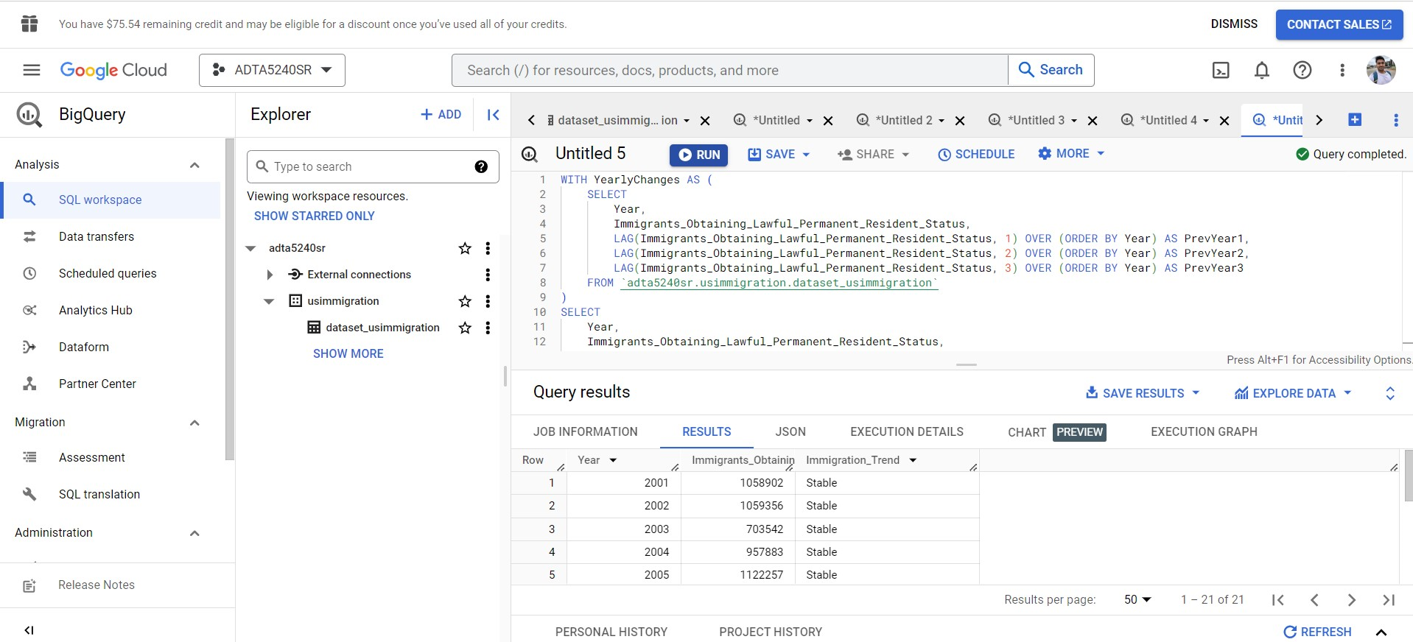
Finding Years with Significant Changes in Immigration Trends

Slide 11
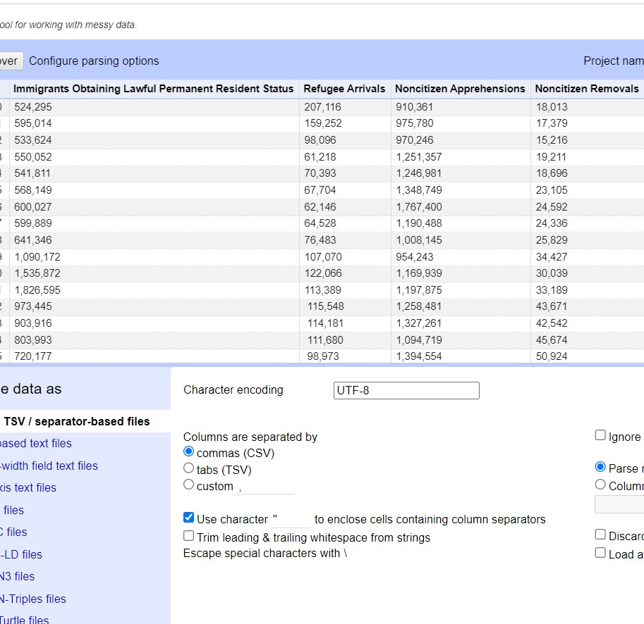
Working on OpenRefine
Creating a Project

Slide 12
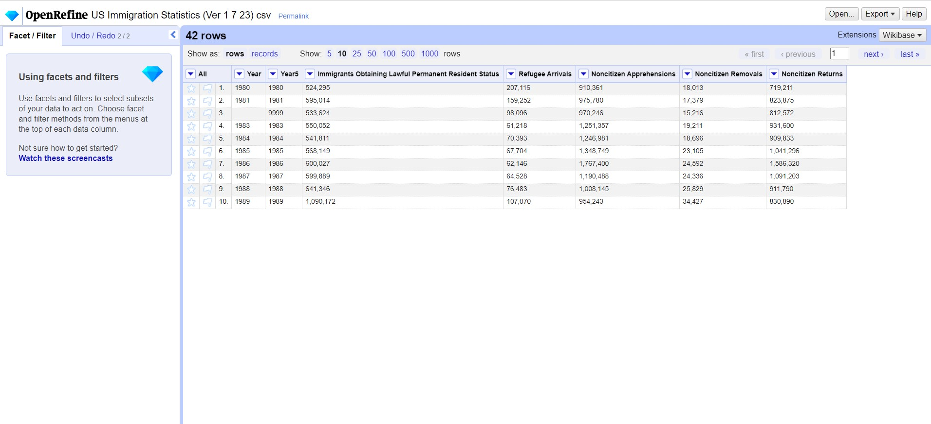
Handling Missing Year

Slide 13
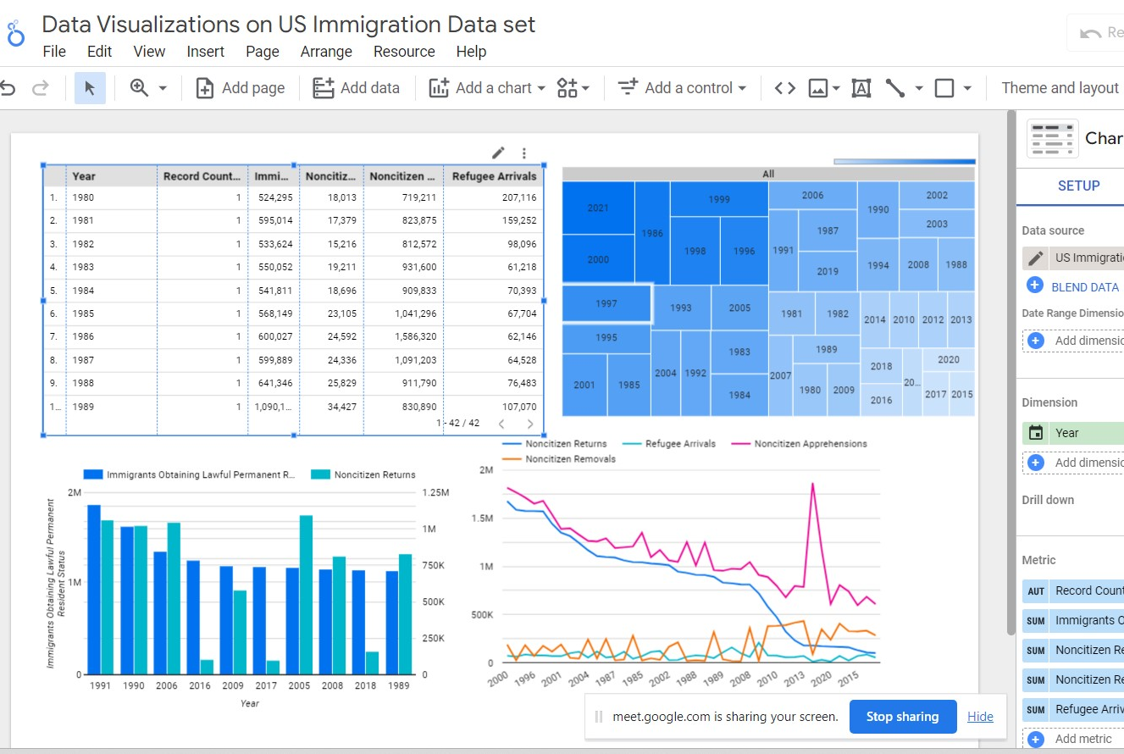
Data Visualizations on Data Studio

Slide 14
Tools Used
Google Cloud Console Platform
Data Studio
Excel

Slide 15


Thank you

